Slide 1
Exploratory Data Analysis

Slide 2
Learning Goals
In this section, we will cover:
- Approaches to conducting Exploratory Data Analysis (EDA)
- EDA techniques
- Sampling from DataFrames
- Producing EDA visualizations

Slide 3
What is Exploratory Data Analysis?
Exploratory data analysis (EDA) is an approach for analyzing data sets to summarize their main characteristics, often with visual methods.

Slide 4
Why is EDA Useful?
EDA allows us to get an initial feel for the data.
This lets us determine if the data makes sense, or if further cleaning or more data is needed.
EDA helps to Identify patterns and trends in the data
(these can be just as important as findings from modeling).

Slide 5
Techniques for EDA
Summary Statistics:
Average, Median, Min, Max, Correlations, etc.
Visualizations:
Histograms, Scatter Plots, Box Plots, etc.

Slide 6
Tools for EDA
Data Wrangling:
Pandas
Visualization:
Matplotlib, Seaborn

Slide 7
EDA: Job Applicant Summary Statistics
Suppose we want to examine characteristics of job applicants:
Average: we could look at the average of all interview scores
(perhaps by city or job function).
Max: we could look at most common words applicants use in
application materials.
Correlations: we could look at the correlations between technical
assessments and years experience
(perhaps by type of experience).

Slide 8
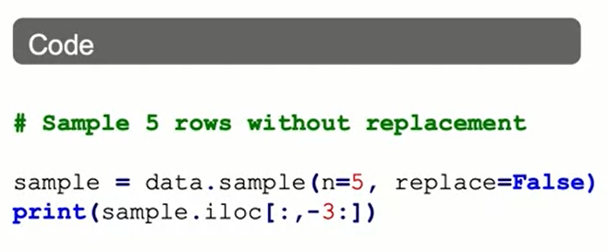
Sampling from DataFrames
There are many reasons to consider random samples from DataFrames:
For large data, a random sample can make computation easier.
We may want to train models on a random sample of the data.
We may want to over- or under-sample observations when outcomes are uneven.

Slide 9
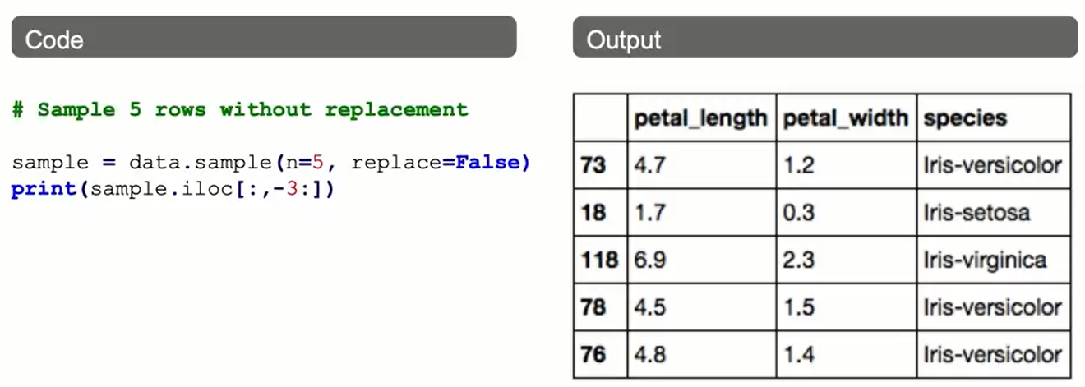
Sampling from DataFrames

Slide 10
Visualization Libraries
Visualizations can be created in multiple ways:
- Matplotlib
- Pandas (via Matplotlib)
- Seaborn
Statistically-focused plotting methods
Global preferences incorporated by Matplotlib

Slide 11
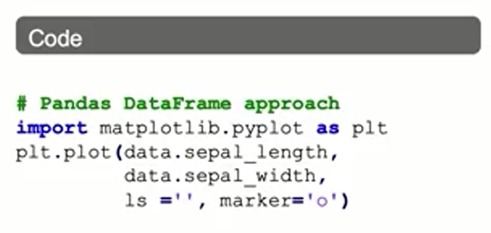
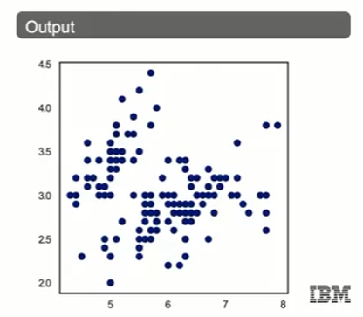
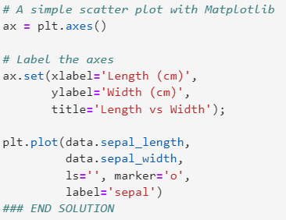
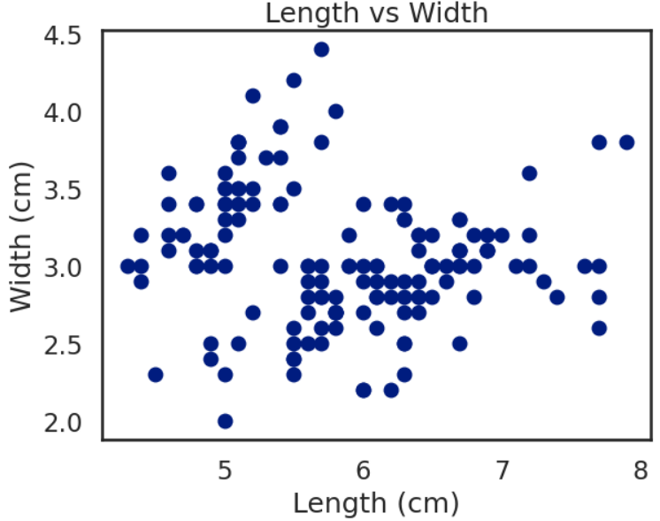
Basic Scatter Plots with Matplotlib

Slide 12
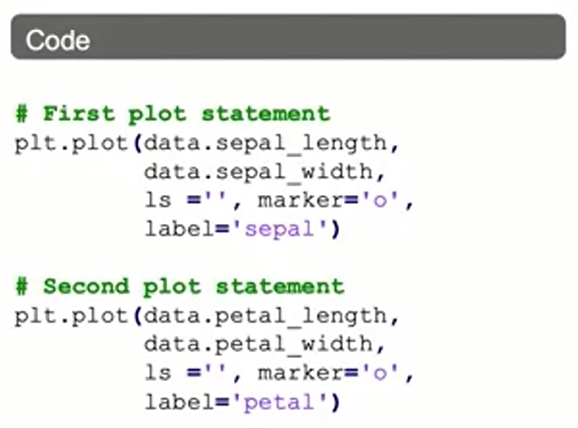
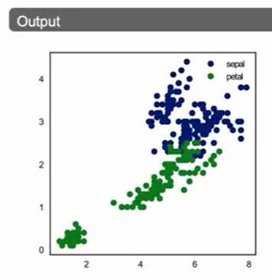
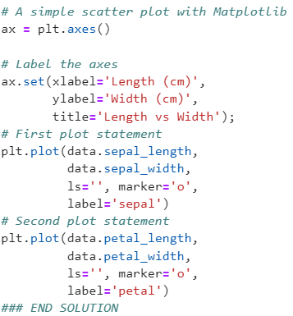
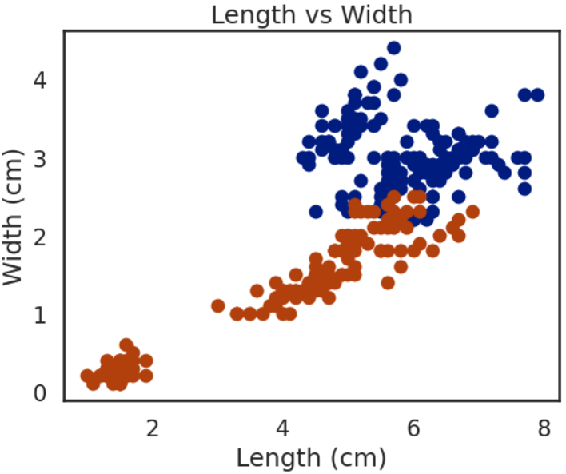
Scatter Plots with Multiple Layers

Slide 13
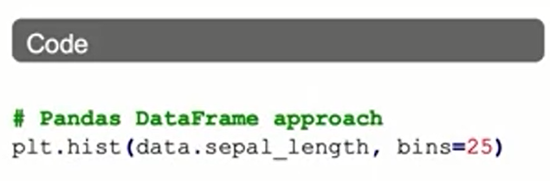
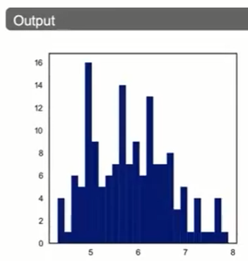
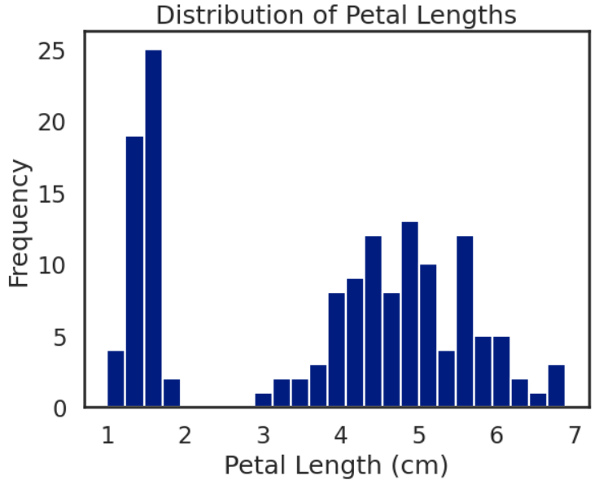
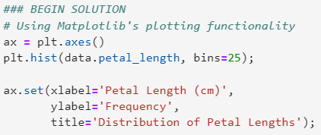
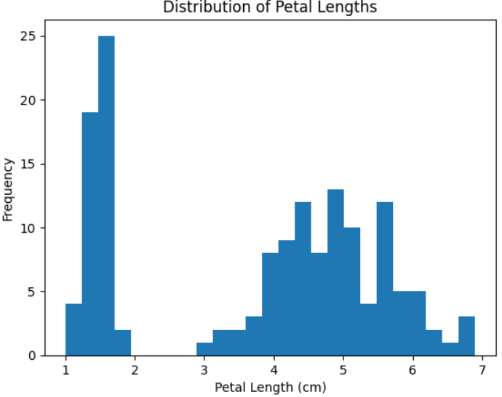
Histograms

Slide 14
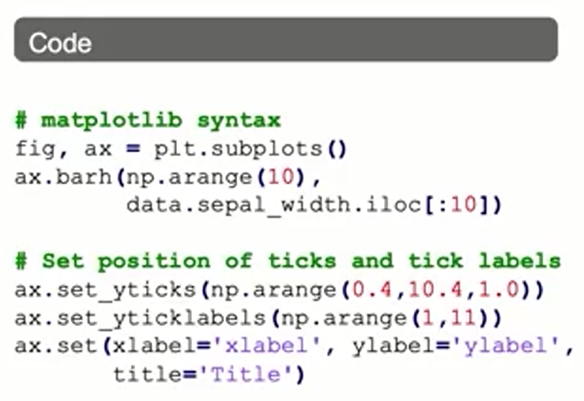
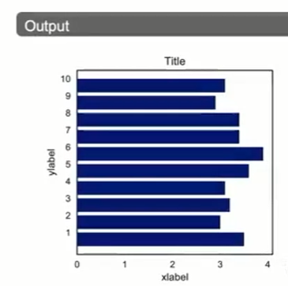
Customizing Plots

Slide 15
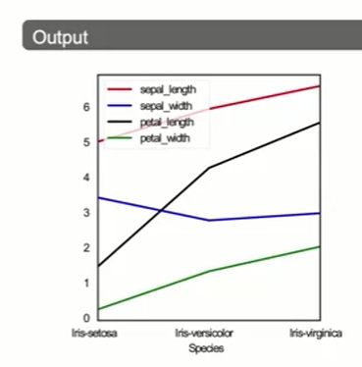
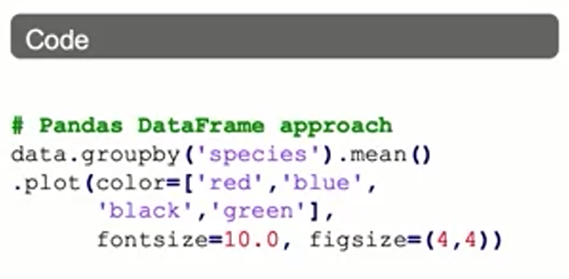
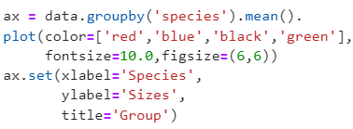
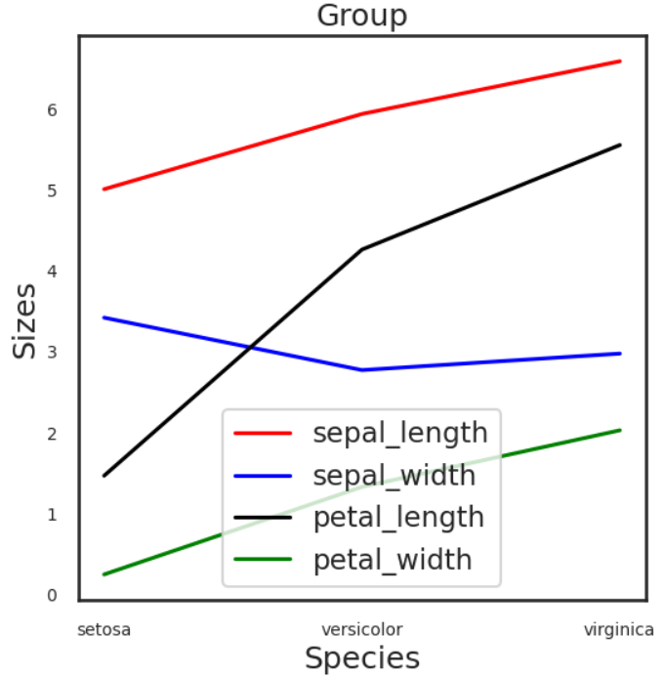
Customizing Plots: by Group

Slide 16
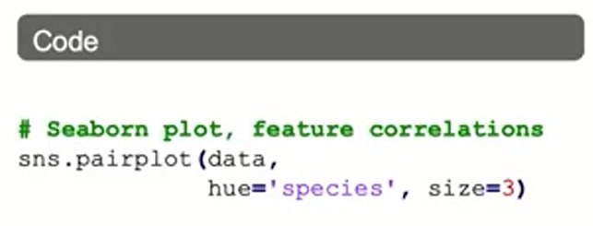
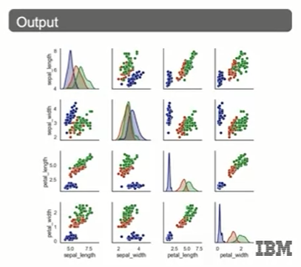
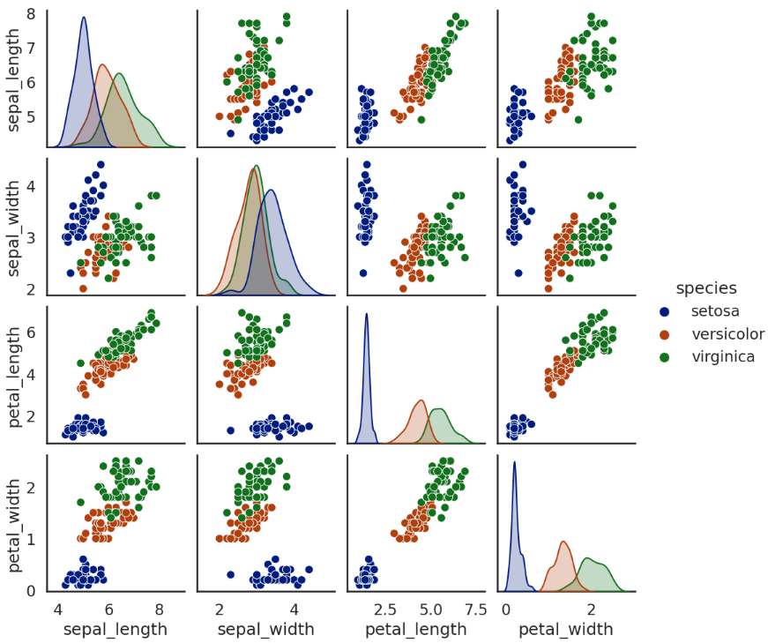

Pair Plots for Features

Slide 17
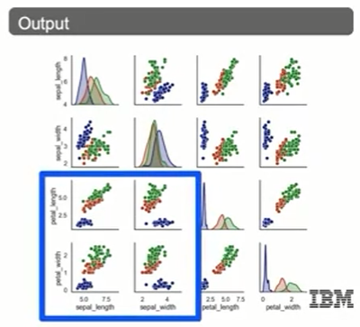
Pair Plots for Features

Slide 18
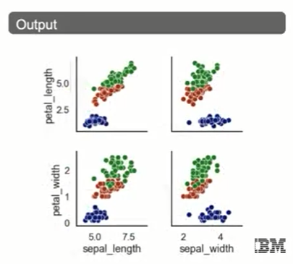
Pair Plots for Features

Slide 19
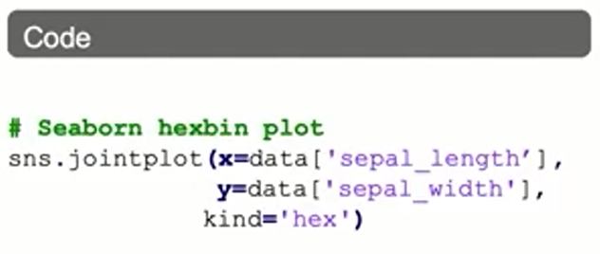
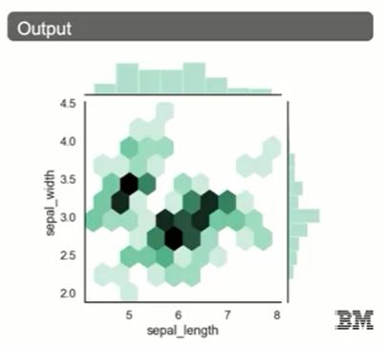
Seaborn Example: Hexbin Plot

Slide 20
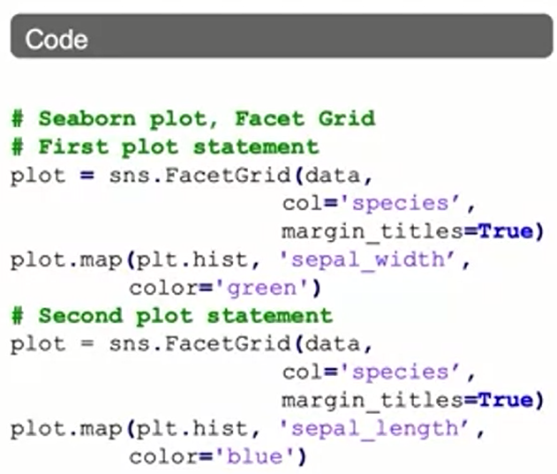
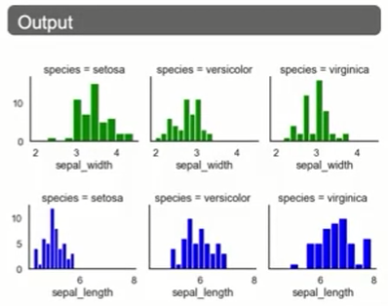
Seaborn Example: Facet Grid

Slide 21
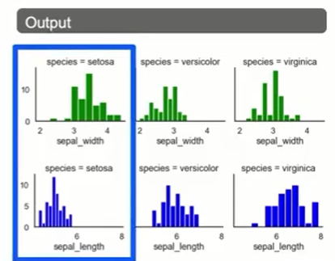
Seaborn Example: Facet Grid

Slide 22
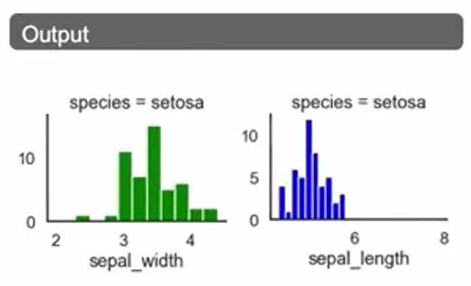
Seaborn Example: Facet Grid

Slide 23
Summary
Exploratory Data Analysis
EDA is an approach to analyzing data sets that summarizes their main characteristics, often using visual methods. It helps you determine if the data is usable as-is, or if it needs further data cleaning.
EDA is also important in the process of identifying patterns, observing trends, and formulating hypothesis.
Common summary statistics for EDA include finding summary statistics and producing visualizations.

Slide 24
Learning Recap
In this section, we discussed:
- Approaches to conducting Exploratory Data Analysis (EDA)
- EDA techniques
- Sampling from DataFrames
- Producing EDA visualizations

